Slide 1



Slide 2

ONLINE CONSTRUCTION HANDLING
Supervised by:
Mam Mehreen Wahab
Group Members:
Mudassir Yasin(FA17-BSE-002)
Abbass Ahmad(FA17-BSE-024)
Department of Computer Science
COMSATS University Islamabad, Attock Campus

Slide 3

Introduction
This is an online construction handling web application, which is being designed to facilitate the customer and the contractor as well. It can help people in construction houses, shops etc. The physical construction work is good but sometimes many people don’t have time to go and search for the items they need. It can also facilitate contractor. Sometimes the contractor doesn’t have enough sources to fulfill his needs. So, the contractor can use our web application to save his time and fulfil his needs.
_______________________________

Slide 4
Anyone who interested in construction or giving the services of construction will register through system.

Slide 5
Project background:
As the world is now the “World of Internet” and everything is now available within the home to everyone. So, leading this concept, we aim to develop a system where every user will have the access of available production work form their homes in Pakistan. Also, any user can construct any project related to construction through our system without having to go outside. Any user will have to register into our system for the buying of material and hiring contractor.

Slide 6
Functional requirements:
As the name suggests, function means those requirements that a system perform operation on a specific situation. An operation and function are performed as a specific set of behavior between outputs and inputs. Functional requirements involve technical details, calculations, logic, processing, and data manipulation of a system.

Slide 7
Administrator
Registration
Login
Web Admin Panel
Chat
Rating

Slide 8
Non-Functional Requirements:
Non-functional requirements are those requirements that take part with functional requirements to help and define the system quality .

Slide 9
Reliability
Security
Availability
Robustness

Slide 10
Data Modeling :
In the sub section, we will make a project design of our web application. Data modeling is a type of software modeling techniques in which we design our project in terms of data passing.

Slide 11
Sequence Diagram
Data Flow Diagram
Activity Diagram

Slide 12
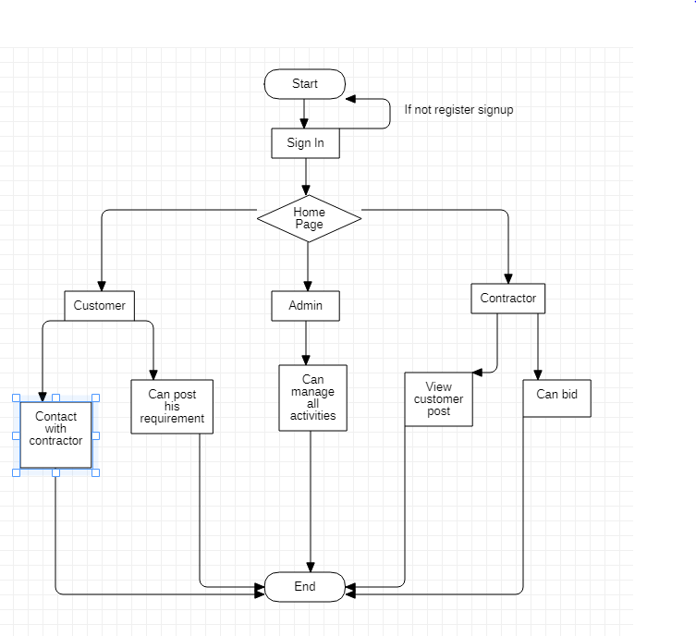
Working Flow:

Slide 13
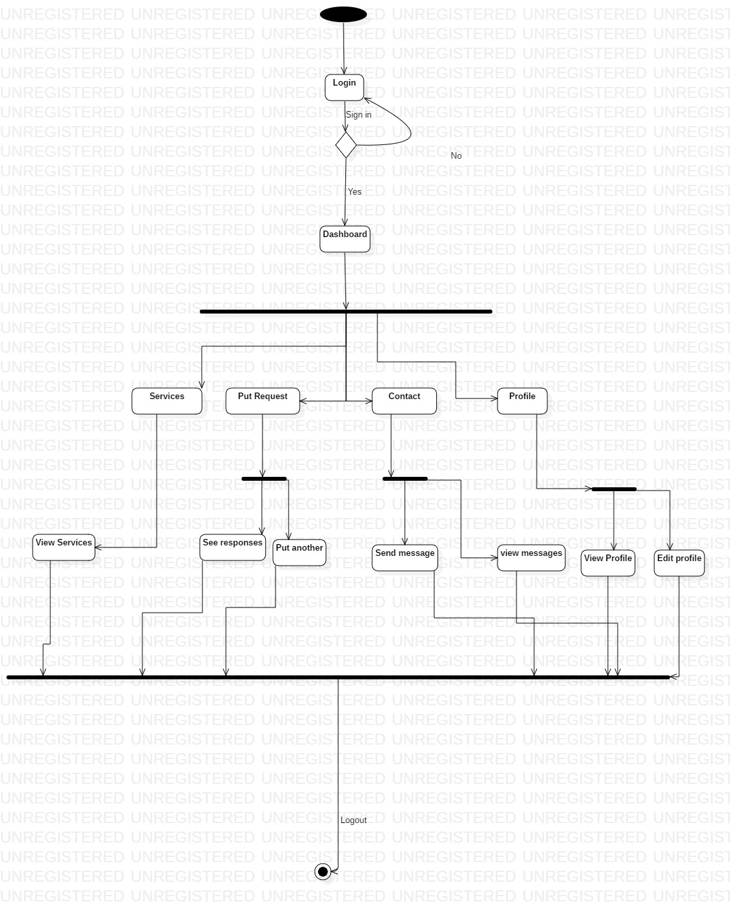
Customer flow:

Slide 14

Contractor:

Slide 15
Problem statement
To built a house or any type of construction one can visit to different contractors and it is a very time consuming thing.
Person can’t be able to visit as many place due to which some times it may leads to quality compromise.
Much of the good contractors are unable to get work due to the lack of awareness.
Buyers are not as much aware from the latest market prices and the new as well as best quality products and contractors present in the market.
_______________________________

Slide 16
Objectives
It is our goal to create an app that will meet the realistic needs of all our construction and will do at home without the time waste.
And it will be our endeavour that we will make this app as effective so that in the shortest possible time it started to be used not only in one city but also in other cities.
In this web app we focused on best quality and reasonable price .
_______________________________

Slide 17
Development Requirements
Software Requirements dependence:
HTML
CSS
JavaScript
STARUML
SQL server
PHP
XAMPP server

Slide 18
Xampp server:
XAMPP is a free and open-source cross-platform web server solution and it consist of Apache HTTP Server, Maria DB database and interpreter for scripts.
Such as we are developing a project, for the website developing we are using XAMPP.

Slide 19
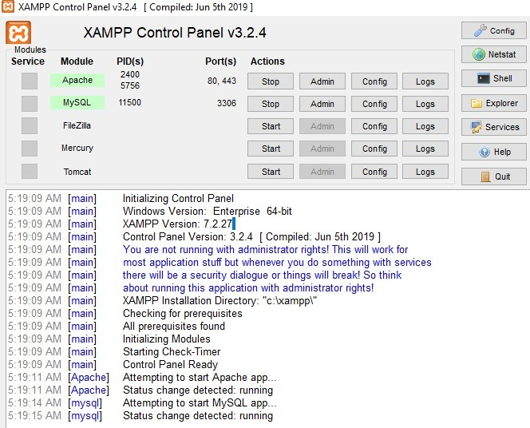

Slide 20
Database used:
MY SQL:
We are using MYSQL database for our project and this will work when XAMP server will be open just like show in above picture. MYSQL is an open-source relational database management system.
We are developing android and web-based project so that is why we are using relational database.

Slide 21
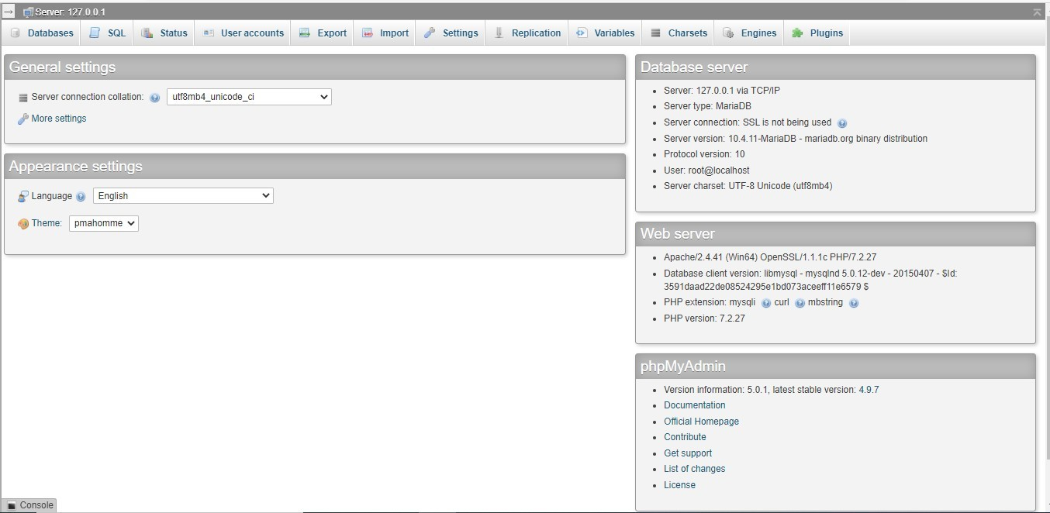

Slide 22
Sign up:
If the user is new and can’t have his account then he clicked on signed up button, the page will appear and user have to fill all the options and then they will be able to signed in as customer.

Slide 23
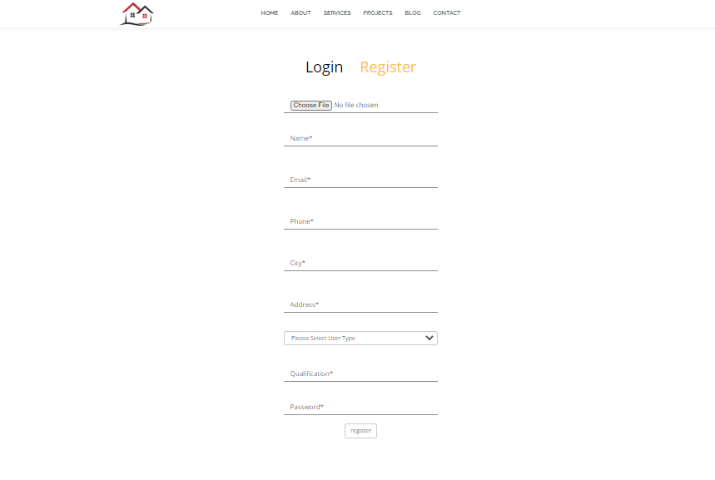

Slide 24
Login Page:
We started the project by creating a web page that is our login page. Firstly, the user has to be signed up and if he already has an account, he enters his email and password and click on Log in button he will allowed to Log in.

Slide 25
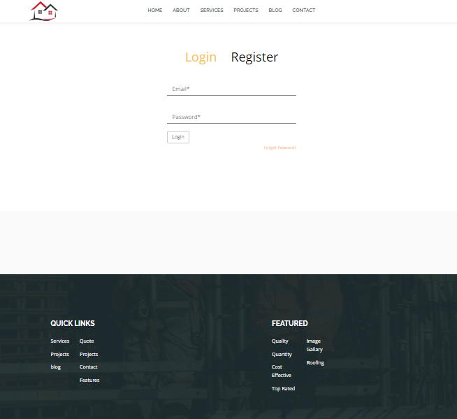

Slide 26
Forgot Password:
If user forgot the password, he will click on forgot password then he will redirect to the page where user add their email and submit it and then login and proceed further.

Slide 27
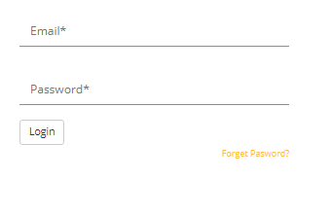

Slide 28
Home page:
When user will create their own account and account is verified the user can view home page.

Slide 29
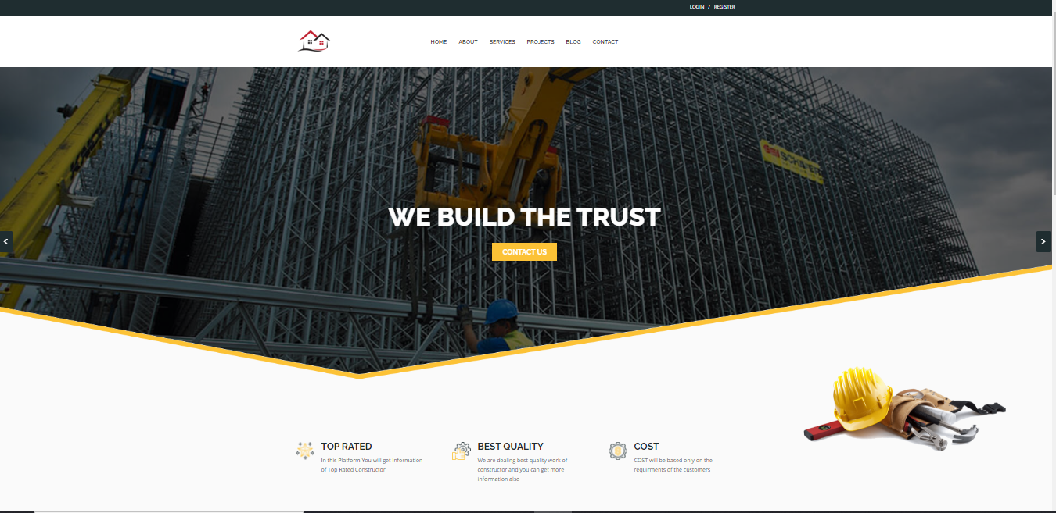

Slide 30
About Us:
About us page contain information of our website.

Slide 31
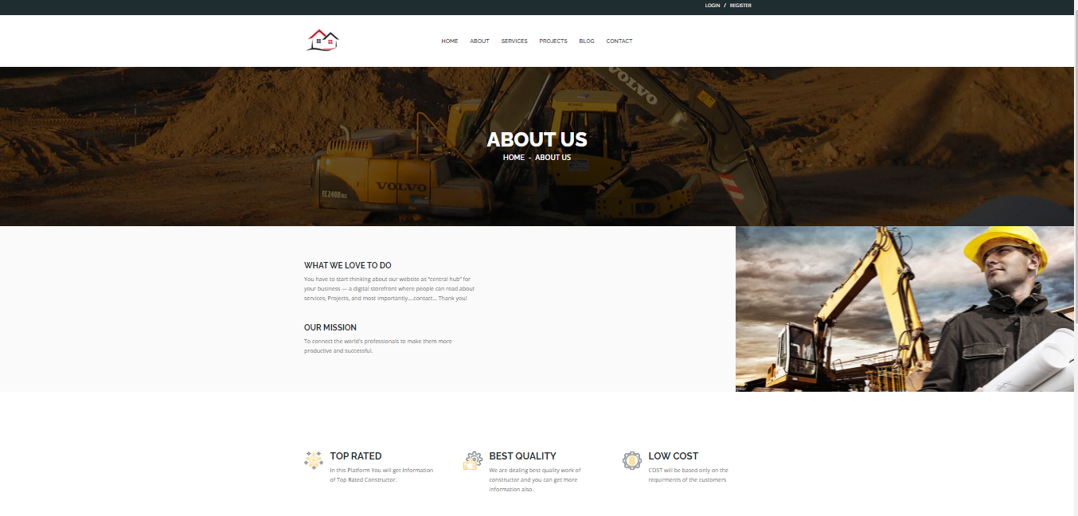

Slide 32
Contact Us:
If user wants to give any suggestions or user have any issue he can contact with admin through contact us page.

Slide 33
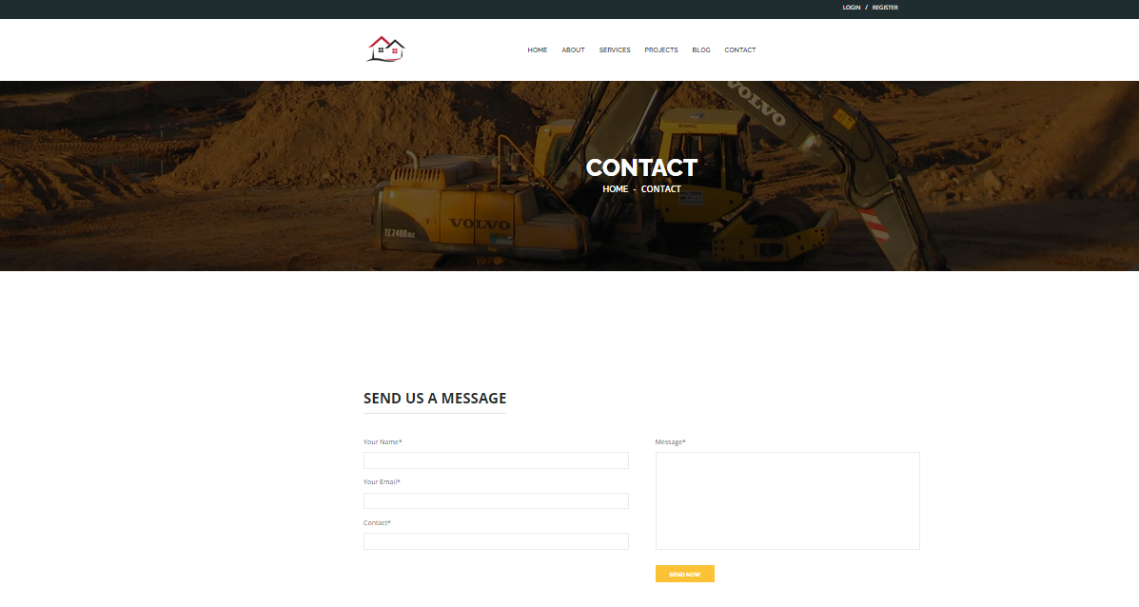

Slide 34
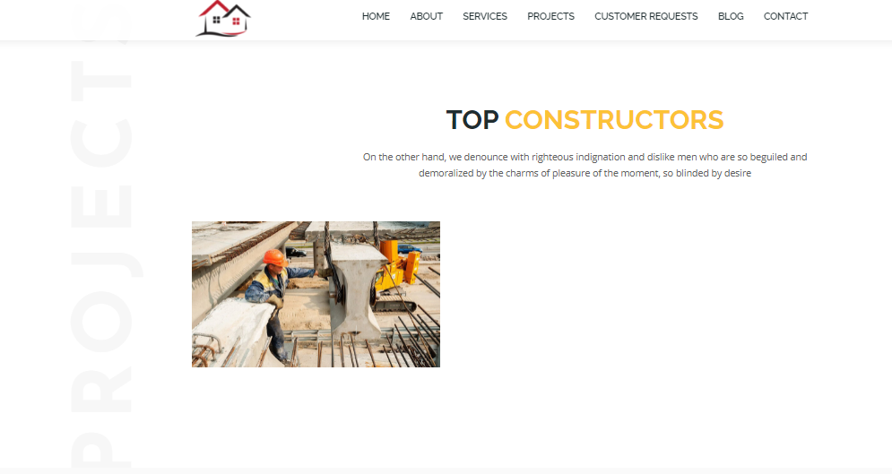
Top Constructor page:

Slide 35
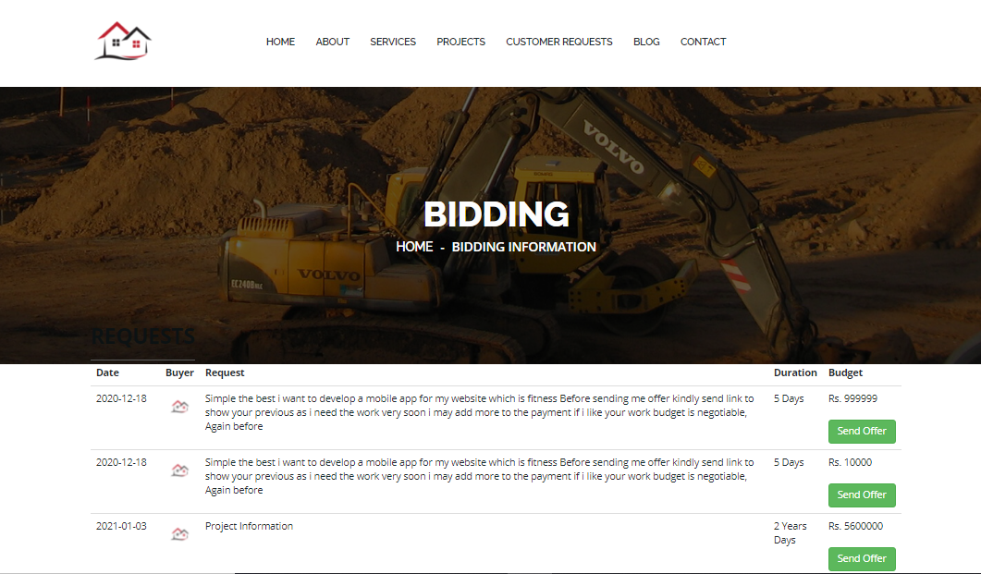
Customer Request:

Slide 36
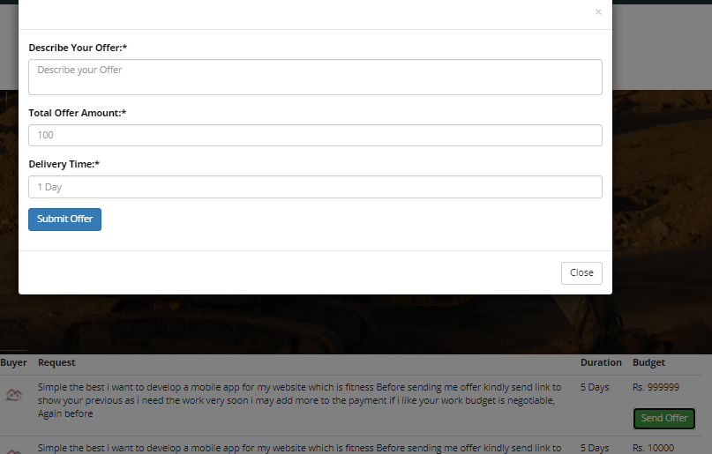
Send Order:

Slide 37
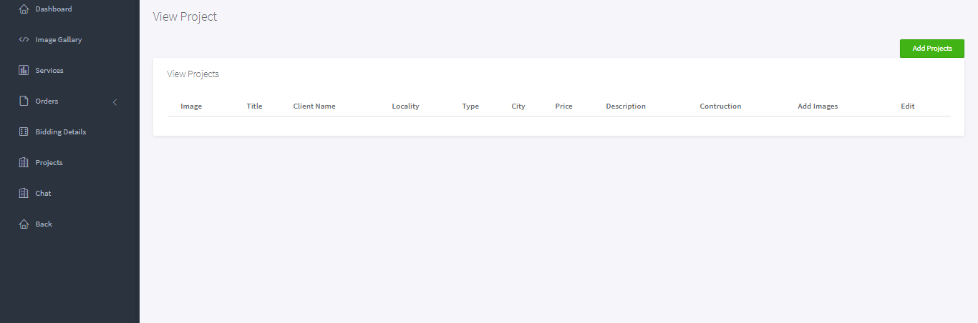
View projects:

Slide 38
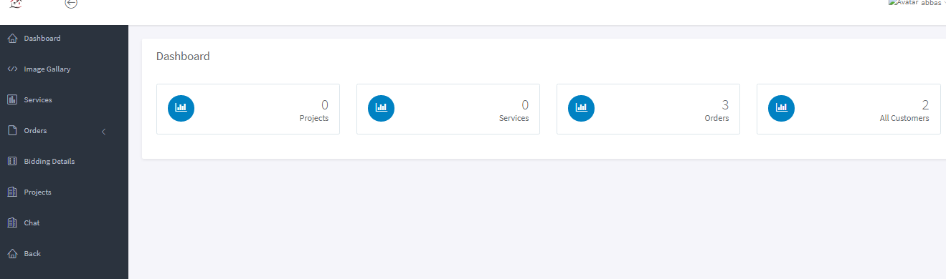
Contractor Account:

Slide 39
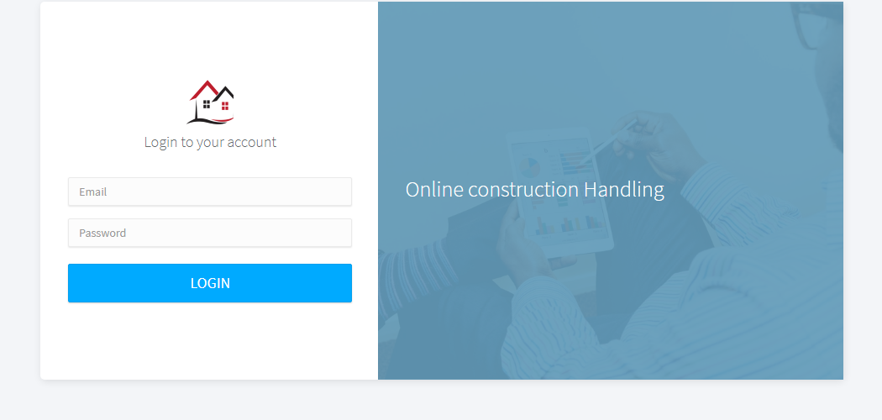
Admin Login:

Slide 40
Contractor Dashboard:

Slide 41
Store rating in the database tables:
After user add rating in any product that record will be store in the database to used it further for the recommendation. We store the following information of every user in the database: reviews, total reviews, people (how many reviews in total), review message.

Slide 42
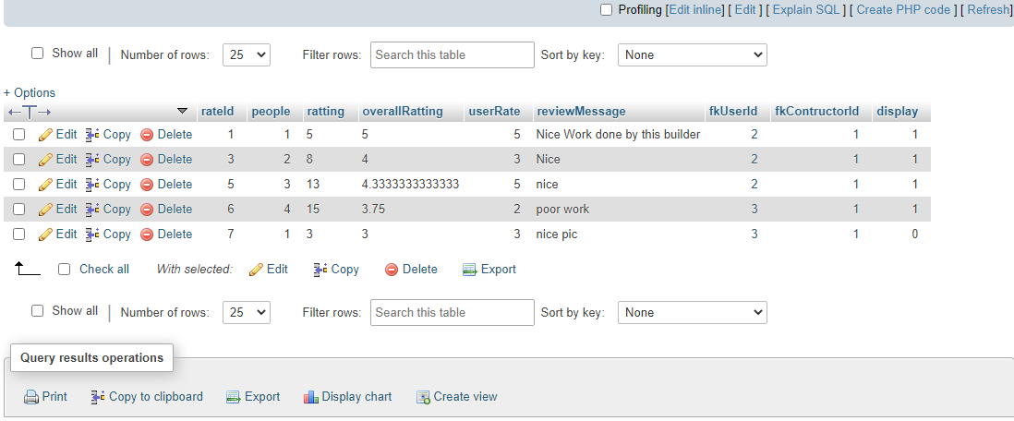

Slide 43
System Testing:
In system testing a complete and integrated system is tested. Our focal point throughout the designing and implementation was to test each unit. User activities regarding with user’s registration properly tested and stored in database.

Slide 44
Two type of testing:
Unit Testing
System Testing

Slide 45
Unit Testing:
IT’S a level where we test each individual component while being developed for the conformance to desired requirement. This testing was applied to both login and registration portions in case if our user enters some incorrect value then a message will be shown to put correct entry.

Slide 46
System Testing:
We have focused on thorough testing through-out the design and implementation phase while testing the user and admin all the other activity that they perform should be stored in database.

Slide 47
Conclusion:
In this project we developed a web-based system “Online Construction Handling”. It is very useful application as online work is getting better day by day. Now a days everyone wants to work and handle things from his home and laptop. So, we provided them opportunity in the field of construction. Its difficult for a person who want things related to construction to go out and search contractors. Also, difficult to discuss rates or find better pricing for his work. Solving this problem our website provides them opportunity to see blogs, contractors, projects, and ideas about the construction.

Slide 48
Future work:
We will add other products as construction materials in our website. We aim to provide online payment methods and mobile app to the user so they can easily handle the payments online. We also aim to provide the customer more functionalities like searching different products related to construction, buying them and getting those at their doorstep. Moreover, there are a lot of ideas we aim to bring them to the website so it can become a better market place for both customer and contractors.

Slide 49
Benefits
We designed web application through which a customer can easily find all the services and contractors related to his construction work at home by saving their time and unnecessary efforts.
In this specific case of construction dealing, customers have to suffer from many issues to find different contractors/services for construction and it is a difficult process to find a good quality at reasonable price at a single plate form.
_______________________________

Slide 50
References:
Unknown, “Website | Definition of Website by Merriam-Webster,” Merriam-Webster Dict., 1993.
R. Pressman, Software engineering: a practitioner’s approach. 2005.
S. Ambler, “Technical (Non-Functional) Requirements: An Agile Introduction,” Agil. Model.
G. Sparks, Database Modeling in UML. .
https://developers.google.com/web/updates/2019/02/model-viewer
https://www.polymer-project.org/
https://www.youtube.com/watch?v=wkSA9bfCmKU&list=PL0b6OzIxLPbz1cgxiH5KCBsyQij1HsPtG
https://www.youtube.com/watch?v=314m7YBRFvQ&list=PL6n9fhu94yhXd4xnk- j5FGhHjUv1LsF0V
[9] https://developers.google.com/machine-learning/recommendation/collaborative/basics [11] [10] https://link.springer.com/chapter/10.1007/978-3-540-72079-9_9
[11] https://www.geeksforgeeks.org/user-based-collaborative-filtering
https://en.wikipedia.org/wiki/Sublime

